Slide 1



TAKE-TWO INTERACTIVE SOFTWARE INC. (Nasdaq : TTWO) Poised for a Breakout — Global Gaming Leader Positioned for Re-Rating on Blockbuster Pipeline
June 26 2025
Syed Yaseer Rahman 40455377 MSc Financial Risk Management
Recommendation : Buy
Target Price : $268.31; 12.5% *Valuation based on blended DCF (80%) and Relative Valuation (20%)* Closing Price : $238.37 *as of June 26 , 2025*

Slide 2














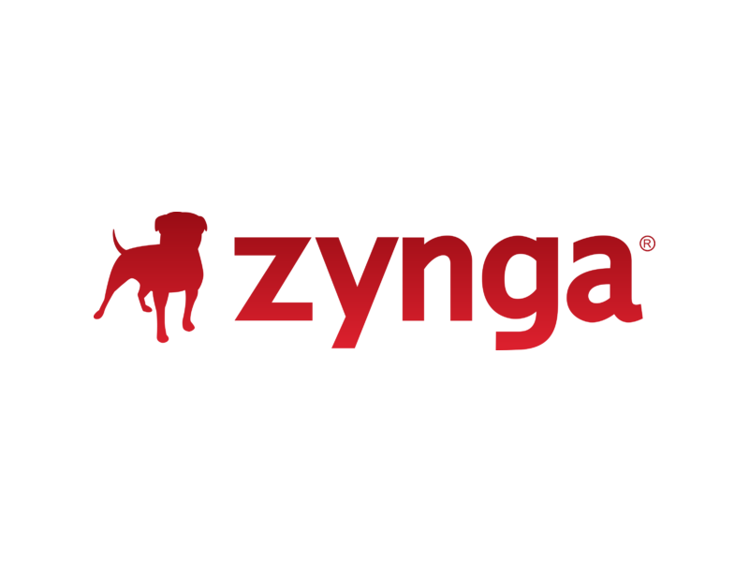
Investment Thesis
Despite it’s age, GTA V continues to generate millions in annual revenue and is the second most watched game on Twitch.
GTA VI History Suggests Material Upside; Market Growth Expectations Remain Modest — Past GTA titles delivered +25% revenue CAGR in first 2 years — current valuation implies only ~8% growth priced in
$ ? B
GTA VI
2026 Launch Anticipated to Redefine Industry Records
$7.7B
$2B
GTA V
GTA IV
GTA VI — Gaming's Most Anticipated Blockbuster, Poised to Redefine Revenue Cycle
Fastest 1B sales in entertainment history
Revenue
3 B + anticipated pre-order sales in first year
Recurring Digital Ecosystem Accelerating High-Margin, Cash-Generating Growth
$100 M
Cost to produce
Trailer 2 – 475M + cross-platform views in 24 hrs
$265 M
Still under development so costs could potentially rise.
World-Class IP Moat and Robust Pipeline Driving Durable Outperformance
$2 B (approx.)
Trailer 1 – 93 M+ views in first 24 hrs
$5,950 - $6,050 (E)
Net Bookings Breakdown by Source ($ in millions)
$5,634
Take-Two's Portfolio Flywheel
$5,350
$202
Digital revenue accounts for 96%+ of Take-Two's total revenue — a testament to its scalable, high-margin business model. Mobile remains the largest driver of this digital mix.
450M + units sold
Fy26-Fy 28 Pipeline
$237
79% of Total
79% of Total
Immersive Core –
deepest gameplay +
content heavy titles
140M + units sold
$5,112
$5,432
Mobile represents ~51% of FY25 Net Bookings — underscoring its role as the engine of digital growth
100M + units sold
Mobile
Mobile revenue grew +7% YoY in FY25 — reinforcing Take-Two's expanding digital growth trajectory.
93M + units sold
New Iterations of
Previously Launched
Titles
FY 25
200 M + MAU’s (monthly active users) + 5 B + downloads
FY 24
FY 26 E
Recurrent Consumer Spending
Physical & Other
Digital
Source: Company Reports, FY24-FY26E. FY26 figures represent management guidance; Capital IQ;

Slide 3
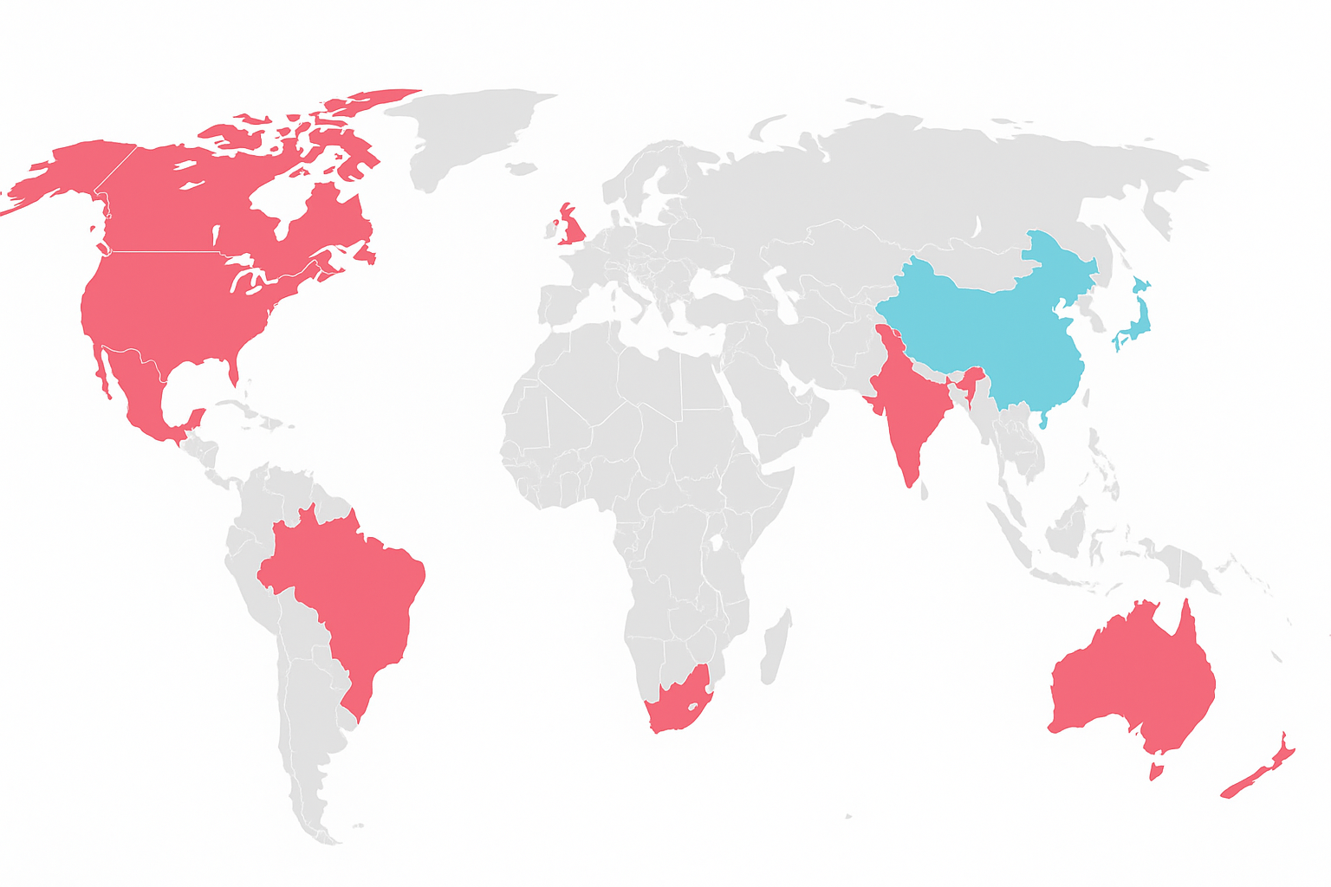










Business Overview
London, European HQ; Console/PC
New York, USA
Development Studios; Console/PC
17 + Development Studios (USA, Canada, Europe and India)
60.4 % Global Revenue from USA
NY, USA – Global HQ; Rockstar, 2K studios; Console/PC;
Mobile Publishing Hotspot and Biggest Mobile Segment Market
11,000 + employees globally
Bengaluru, India Mobile Development Studio; Major Mobile/Digital Market
Recent M&A: Zynga ($12.7 B),
Gearbox ($ 460 M), Rollic etc.
Console/PC; Mobile Penetration
A global publisher of interactive entertainment, evolving from a console-focused model to a mobile-scaled, recurring, digital-first revenue business
Console/PC; Mobile Penetration
Console/PC Major Publishing + Animation Studios
Physical Game Sales
Digital Game Sales
Live Services & DLC
Recurring Revenue Ecosystem
Reinvestment : R&D; Acquisitions
TO
Pre 2010
2010 - 2020
2020 - Present
How T2 makes money
Full Game Sales + IP Creation – 21% of Revenue Console, PC, Mobile premium game purchases
Content Revenue Mix
Recurring Consumer Spending | 79.4%
Full Game and Other | 20.6%
Platform Revenue Mix
Mobile | 52.2%
Console | 37.3%
PC & Other | 10.5%
Distribution Channel Revenue Mix
Digital online | 96.4%
Physical retail and other | 3.6%
T2’s Moat
Recurring Consumer Spending – 79% of Revenue Includes GTA online, NBA 2K VC, Mobile in-app purchases; Includes Virtual Currency (NBA 2K VC, GTA Online Shark Cards);
Extended Monetisation
Mobile in-app purchase (within RCS) – 41-43% of Mobile Revenue Driven by Zynga portfolio
Advertising Revenue (mobile driven) – 6% of Revenue Hyper-casual and Zynga mobile ads
Trad. Peers
Lifecycle Revenue Expansion
Licensing and Merchandising - ~2 – 3 % of Revenue Licensed IP’s, merchandise, partnerships
Launch Window
Year 1 & Beyond
Source: Company Reports, FY25; Q4 FY25 Earnings Report; T2 Investor Relations; Capital IQ;

Slide 4
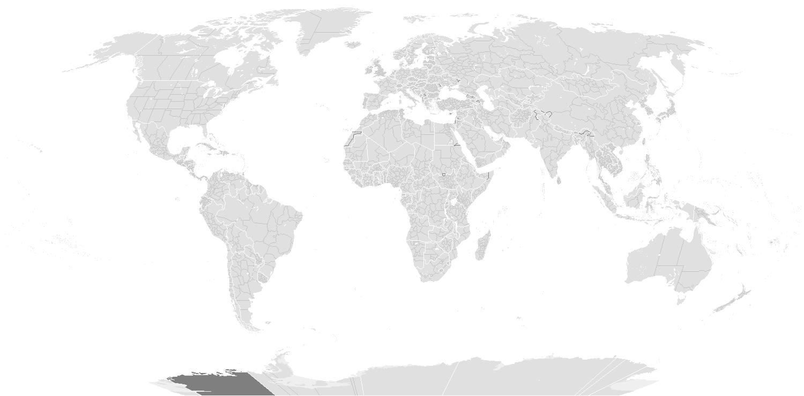

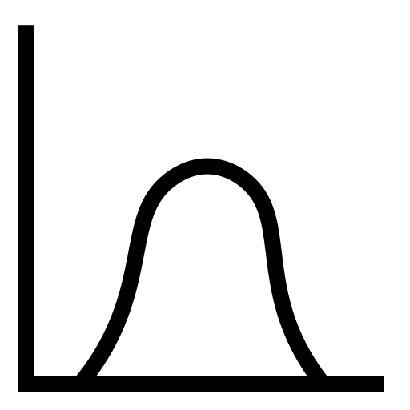






Industry Overview
Revenue by Region
Rapid growth correction post-pandemic
+1%
North-America 27%; +0.6% YoY
Europe 23%; + 3.2% YoY
$221B Global Gaming Industry – Projected to reach + 266B by 2028
Asia–Pacific 43%; +1.5% YoY
CAGR
+13%
212
205
+5% CAGR
151
132
Rest of the World 7%
$3.3B (approx.) global video game players in 2024
~$150B in-app purchase revenue across iOS and Google Play Store in 2024
Revenue by Segment
Mobile 49%
Console 30%
PC 21%
Gaming-as-a-platform shift – game engines and virtual words beyond entertainment
Blockbuster IP (38 in Pipeline) /GTA VI Supercycle
Interactive entertainment market estimated to reach ~$195B
in FY26
Mobile Boom
Pandemic Demand Normalisation
Multi-Year Monetisation Runways
In-Game Monetisation/Ads/Subscription
AR/VR, AI and UGC platform tailwinds
T2 positioned to capture growth; T2 poised to grow nearly 2x faster than industry. DCF implies ~8–9% revenue CAGR vs. ~4–5% global gaming market
Major Title Delays (e.g. GTA VI)
2017-2021 High Growth Drivers (+13% CAGR)
2022-2024 Slowdown (+1% CAGR)
2025 + Outlook +3-+5% CAGR FY2025 - FY2030
Zynga mobile monetisation – capture mobile recovery efficiently
Pandemic user surge – stay-at-home
Emerging Markets APAC, LatAm digital expansion
Price Inflation; Costs > Revenue; Layoffs
Franchise strengths + Live Services Scaling
Advanced game engines/RCS infrastructure/AI driven content gen.
Monetisation fatigue in mature markets
Anticipated boost from major releases (GTA VI)
Source: Company Reports, FY24-25; Q4 FY25 Earnings Report; T2 Investor Relations; Consensus Reports; BCG.com; DFC Intelligence; Capital IQ; Bloomberg;

Slide 5



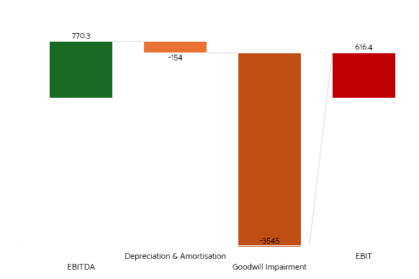
Financials (Income Statement)
Income Statement
Metric | FY 23 ($M) | FY 24 ($M) | FY 25 ($M)
Revenue | 5350 | 5450 | 5634
Gross Profit | 2830 | 2929 | 3277
Operating Income | (576) | (457) | (451)
Net Income | (1125) | (3744) | (4479)
EBITDA | 556 | 520 | 449
R&D Expense | 888 | 948 | 1005
D&A | 122 | 171 | 190
Impairment of Goodwill | NA | (2342) | (3545)
Gross Margin % | 52.9% | 53.7% | 58.1%
EBIT Margin % | (10.8%) | (8.4%) | (8%)
Net Income Margin % | (21%) | (69.9%) | (79.5%)
EPS | (7.03) | (22.01) | (25.58)
Revenue - Stuck in Neutral - 2.6% 3yr Revenue CAGR — muted, pipeline-dependent;
IP Rich, Revenue Poor – for now.;
Heavy R&D ($1B+) and pipeline costs fueling losses;
✔ EBIT improves slightly — signal of cost base stabilizing
But: Revenue plateau + operating loss combo = risky in hit-driven sector
Gross Profit — Monetisation Moat Intact, But Ceiling in Sight; Mobile margin drag & rising content costs cap further expansion;
NI – FY 23 ($1.1B)
NI – FY 24 ($3.7B)
NI – FY 25 ($4.4B)
EBITDA positive - core model strength;
D&A Heavy – Zynga, IP amortization elevate EBITDA/EBIT spread;
Goodwill hit – non-cash, mobile recalibration;
EBIT loss – optical, not cash reality;
P&L Weak – Optical losses driven by non-cash Zynga/IP impairments — cash reality more stable
EPS Collapse – headline grabbing but distorting; Investor focus toward margins;
Source: Company Reports, FY23-25; Q4 FY25 Earnings Report; T2 Investor Relations; Consensus Reports; Capital IQ;

Slide 6

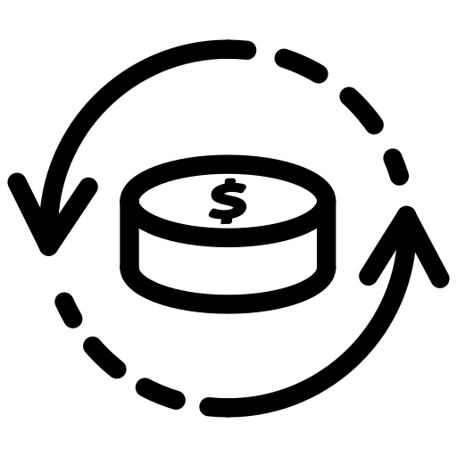

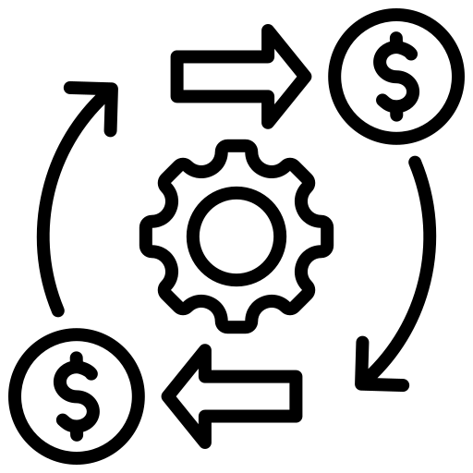





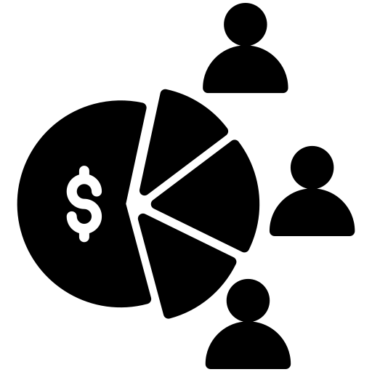

Financials (Balance Sheet & Cash Flow)
Cash Flow
Metric | FY 23 ($M) | FY 24 ($M) | FY 25 ($M)
Operating Cash Flow | 1 | (16) | (45)
Un-Levered FCF | 1269 | 976 | 1260
CAPEX | (204) | (142) | (169)
Acquisition Spend | (3311) | (18) | 7
Debt Issuance (Net) | 1882 | 9 | 591
Net Change in Cash | (961) | (133) | 457
Balance Sheet
Metric | FY 23 ($M) | FY 24 ($M) | FY 25 ($M)
Cash & Equivalents | 827 | 754 | 1456
Total Debt | 3487 | 3534 | 4106
Net Debt | 2473 | 2758 | 2640
Goodwill & Intangibles | 12292 | 8933 | 5286
Deferred Revenue | 1857 | 1092 | 1084
Retained Earnings | 1164 | (2580) | (7059)
Total Equity | 9043 | 5668 | 2138
Book Value/Share | 53.54 | 33.18 | 12.07
Tangible Book Value/Share | (19.24) | (19.12) | (17.78)
FCF Resilience - $1.26B despite optical P&L loss; Declining FCF Trend = Concern if pipeline disappoints;
Heavy Reinvestment - CAPEX + M&A outflows reflect content build-up; Necessary but Cash Hungry;
Operating Cash Outflow — driven by dev cycle, consistent with dev-heavy, pre-release phase; Exposure to External Funding = Cash Timing Risk;
Liquidity : Cash rebuilds - $1.4B – pre GTA VI prep; Net Debt stable but remains elevated – legacy M&A lingers
M&A Drag — Zynga/Other deals pressuring cash, strategic rationale; Heavy on B/S;
Goodwill & Intangibles - $12.3B → $5.3B — Impairments reflect IP recalibration; Intangible-heavy balance sheet — valuation reliant on execution
Cash Rebuild FY25 — liquidity stabilising pre-GTA VI cycle
Deferred Revenue - $1.86B → $1.08B — pipeline timing & pre-sales visibility in focus
Net Change in Cash (FY23-FY25)
$457M
$(961)M
$(133)M
Equity & Book Value: Total Equity erosion ($9B → $2.1B) — driven by impairments & P&L losses
Negative Tangible Book Value — structural fragility remains
Cash flow steadier than P&L implies; strategic reinvestment visible, liquidity management key as T2 leans into growth cycle
Source: Company Reports, FY23-25; Q4 FY25 Earnings Report; T2 Investor Relations; Consensus Reports; Capital IQ;

Slide 7
Financials (Ratios)
Metric | FY 23 ($M) | FY 24 ($M) | FY 25 ($M)
Gross Margin % | 52.9 | 57.2 | 58.1
EBITDA Margin % | 10.4 | 9.2 | 8
EBIT Margin % | (10.8) | (8.4) | (8)
Net Income Margin % | (20.6) | (67.9) | (79.5)
Unlevered FCF/Revenue % | 23.7 | 17.9 | 22.4
CAPEX/Revenue % | 3.8 | 2.6 | 3
Net Debt/EBITDA | 4.9 | 5.7 | 5.9
Tangible BVPS $ | (19.24) | (19.12) | (17.8)
ROA % | (3.2) | (2.03) | (2.64)
ROE % | (17.50) | (50.91) | (114.7)
ROC % | (4.34) | (2.63) | (3.65)
R&D as % of Rev. | 16.6 | 17.4 | 17.8
Total Debt/Equity % | 38.6 | 62.3 | 192
What do the numbers really say?
Metric | T2 | Peer Median | Relative Performance
Gross Margin % | 58.1 | 61.8 | ⬇ Slightly Behind
EBITDA Margin % | 8.0 | 25.8 | ⬇ Margin Drag
EBIT Margin % | (8.0) | 19.3 | ⬇ Loss-Making
Net Income Margin % | (79.5) | 16.4 | ⬇ Deep Red (Impairments)
Unlevered FCF / Revenue % | 22.4 | ~25* | ⬇ Slightly Behind (Est.)
Net Debt / EBITDA (x) | 5.9 | 0.8 | ⬇ Highly Levered
R&D as % of Revenue | 17.8 | ~10–15* | ⬆ High Pipeline Focus
Total Debt / Equity % | 192 | 25.7 | ⬇ Balance Sheet Strain
Margins Mixed – Gross Margins Healthy — but EBIT Drag reflects R&D & content costs
Cash Conversion Steady, But Fading
Balance Sheet Strains Emerging – Debt Metrics Creeping – Tangible Equity Deep Dive
Returns Deep in Red – Structural not Cyclical – Goodwill Heavy Assets dilute efficiency
R&D Elevated — pipeline focus, near-term margin trade-off
Gaps appear more execution-driven than structural
*Estimated ranges based on industry standards and peer averages.
T2 remains fundamentally growth-positioned, but ratios expose the near-term financial fragility masked by the pipeline narrative.
Source: Company Reports, FY23-25; Q4 FY25 Earnings Report; T2 Investor Relations; Consensus Reports; Capital IQ; Bloomberg;

Slide 8
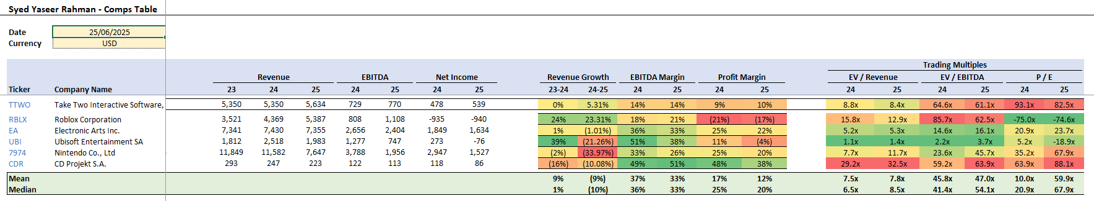
Relative Valuation
TTWO sits mid-pack on growth, but trades at a premium
Valuation still at a premium – 61x EV/EBITDA vs. 54x median, 82.5x P/E vs. 67.9x median
Market pricing in pipeline, not profitability –
Premium reflects IP, M&A potential — not current cash flows
Implied price range shows belief, but risk if margins stall – Market divided: upside on delivery, downside on execution gap
Peer multiples highlight market divergence — execution will drive re-rating
T2 priced for recovery, not perfection — valuation hinges on GTA VI cycle delivery and margin rebuild.
Source: Company Reports, FY23-25.; Capital IQ; - Consensus; Bloomberg;

Slide 9
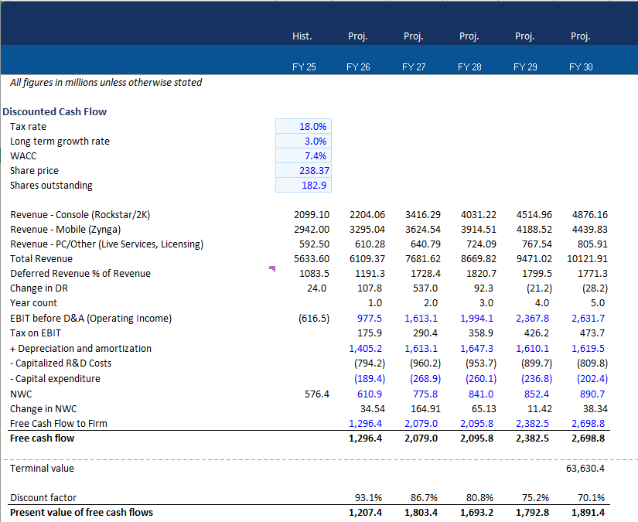
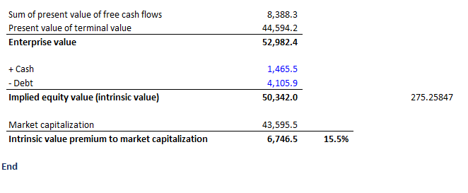
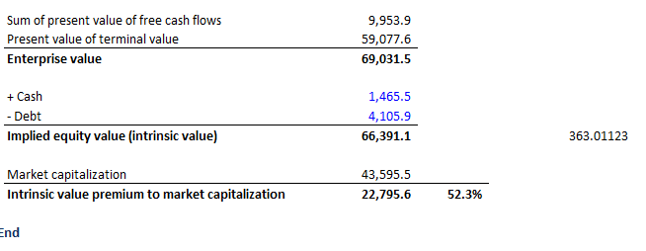
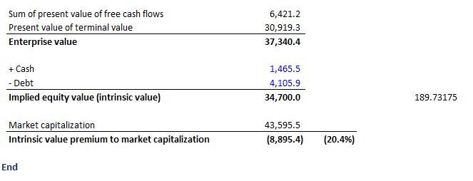
Discounted Cash Flow
Base
Bull
Bear

Slide 10

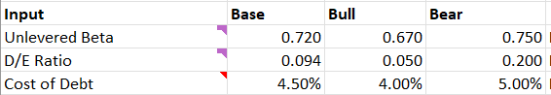
Discounted Cash Flow (WACC and Assumptions)
Risk-Free Rate: 4.00 percent, based on US 10-Year Treasury yield at the valuation date.
Terminal Growth Rate
Equity Risk Premium (ERP): 4.00 percent, based on implied long-term US market premium (Damodaran source)
Base
Bull
Bear
3%
3.2%
2.8%
Size Premium: Zero, as Take-Two is classified as a large to mid-cap, no additional premium applied
Tax Rate
Country Risk Premium: Zero, as Take-Two is US-based with no country-specific risk adjustment required
18% as per Company Disclosures
Unlevered Beta: 0.72; calculated as the average of peer group (EA, Ubisoft, Roblox etc.) unlevered betas using the formula: Unlevered Beta equals Equity Beta divided by one plus Debt-to-Equity ratio multiplied by one minus tax rate. Source : Capital IQ;
Debt to Equity Ratio: 9.4%, based on Take-Two's latest market capitalisation and book value of debt
Cost of Equity: 7.7%; using the Capital Asset Pricing Model: Cost of Equity equals Risk-Free Rate plus Levered Beta multiplied by Equity Risk Premium.
Bull
Bear
7.18%
7.46%
Cost of Debt: 4.5%, benchmarked to comparable BB to BBB-rated US corporates.
After-Tax Cost of Debt: 3.7%, calculated as Cost of Debt multiplied by one minus tax rate.
Scenario Based Inputs
WACC: Weighted average of Cost of Equity and after-tax Cost of Debt based on capital structure weights.
Base
7.37%

Slide 11
Blended Valuation
Calculated a share price of $268.31, an 12.5% premium to last close – Valued Take-Two Interactive using a blended approach consisting of a discounted cash flow model (80%) and a relative valuation (20%).
Discounted Cash Flow Model Drivers:
Revenue growth driven by GTA VI, NBA 2K, Zynga Mobile
Normalised margin expansion post-FY25 (Revenue, EBIT, Deferred Rev., Capitalised R&D etc.)
Capex and working capital based on historical averages and forward-looking adjustments
Terminal growth rate: 3.0%
Tax Rate : 18%
WACC: 7.37%
Last Closing Price
$238.37 ( as of June 26, 2025)
Target Price
$268.31
52-Week Trading Range
$135.24
$245.08
Broker Targets
$144.11
$275
Blended Valuation
$211.25
$275.25
RV – Avg. (EV/EBITDA + P/E Median)
DCF - Base
Relative Valuation Drivers:
Peer Set: Electronic Arts, Ubisoft, Nintendo, CD Projekt
P/E and EV/EBITDA peer medians applied
Excludes outliers and distorted peer multiples
DCF (80%)
$189.7
$363
Bear
Bull
RV (20%)
$209.05
$213.44

Slide 12



Risks and ESG
Low Probability — High Impact
High Probability — High Impact
✔ Cybersecurity & privacy oversight at Board level ✔ Active engagement reduces regulatory blind spots
🟠 Cybersecurity Breach or IP Theft
🟠 Regulatory Shock — Monetisation Restrictions
🔴 Execution Risk: GTA VI Delay or Weak Monetisation
🔴 Market Saturation & Competitive Pressure
✔ Diversified pipeline reduces reliance on GTA VI
✔ Global talent & retention focus supports execution
Low Probability — Low Impact
High Probability — Low Impact
✔ Experienced project teams minimise development slippage
⚪ Minor Cost Overruns or Development Slippage
🔵 Platform Policy Risk (Apple, Google, Sony)
✔ 80%+ owned IP strengthens platform negotiating power
✔ Player fairness & compliance align with platform policies
Catalysts GTA VI Launch Deep IP Pipeline Solid Liquidity & Financial Flexibility
Risks Execution Uncertainty (GTA VI, margins) Regulatory & Platform Headwinds Competitive Pressure
Mitigants ESG Governance & Oversight High IP Ownership (>80%)Global Talent Base

